Slide 1

Secure Digital Currency: Bitcoin
Content may be borrowed from other resources.
See the last slide for acknowledgements!
Amir Houmansadr
CS660: Advanced Information Assurance
Spring 2015

Slide 2
Online Transactions
Physical cash
Non-traceable (well, mostly!)
Secure (mostly)
Low inflation
Can’t be used online directly
Electronic credit or debit transactions
Bank sees all transactions
Merchants can track/profile customers

Slide 3

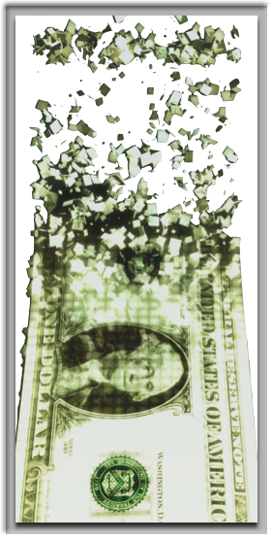
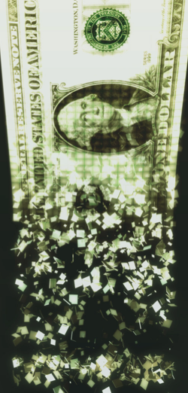
E-Cash
Secure
Single use
Reliable
Low inflation
Privacy-preserving

Slide 4
E-Cash Crypto Protocols
Chaum82: blind signatures for e-cash
Chaum88: retroactive double spender identification
Brandis95: restricted blind signatures
Camenisch05: compact offline e-cash
Various practical issues:
Need for trusted central party
Computationally expensive
Etc.

Slide 5

Bitcoin
A distributed, decentralized digital currency system
Released by Satoshi Nakamoto 2008
Effectively a bank run by an ad hoc network
Digital checks
A distributed transaction log

Slide 6
Size of the BitCoin Economy
Number of BitCoins in circulation 11.8 million (December 2013)
Total number of BitCoins generated cannot exceed 21 million
Average price of a Bitcoin: around $300
Price has been unstable.
Total balances held in BTC 1B$ compared with 1,200B$ circulating in USD.
30 Transactions per min. (Visa transaction 200,000 per minute.)

Slide 7
BitCoin: Challenges
Creation of a virtual coin/note
How is it created in the first place?
How do you prevent inflation? (What prevents anyone from creating lots of coins?)
Validation
Is the coin legit? (proof-of-work)
How do you prevent a coin from double-spending?
Buyer and Seller protection in online transactions
Buyer pays, but the seller doesn’t deliver
Seller delivers, buyer pays, but the buyer makes a claim.
Trust on third-parties
Rely on proof instead of trust
Verifiable by everyone
No central bank or clearing house

Slide 8
Security in Bitcoin
Authentication
Am I paying the right person? Not some other impersonator?
Integrity
Is the coin double-spent?
Can an attacker reverse or change transactions?
Availability
Can I make a transaction anytime I want?
Confidentiality
Are my transactions private? Anonymous?

Slide 9
Security in Bitcoin
Authentication → Public Key Crypto: Digital Signatures
Am I paying the right person? Not some other impersonator?
Integrity → Digital Signatures and Cryptographic Hash
Is the coin double-spent?
Can an attacker reverse or change transactions?
Availability→ Broadcast messages to the P2P network
Can I make a transaction anytime I want?
Confidentiality→ Pseudonymity
Are my transactions private? Anonymous?

Slide 10
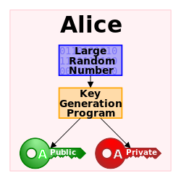
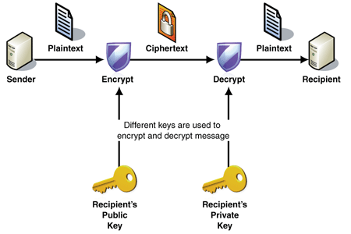
Public Key Crypto: Encryption
Key pair: public key and private key

Slide 11
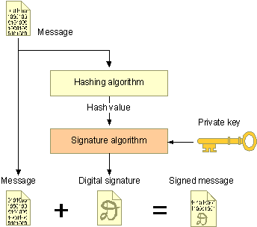
Public Key Crypto: Digital Signature
First, create a message digest using a cryptographic hash
Then, encrypt the message digest with your private key
Authentication
Integrity
Non-repudiation

Slide 12
Cryptographic Hash Functions
Consistent: hash(X) always yields same result
One-way: given Y, hard to find X s.t. hash(X) = Y
Collision resistant: given hash(W) = Z, hard to find X such that hash(X) = Z
Hash Fn
Fixed Size
Hash
Message of arbitrary length

Slide 13
Back to BitCoin
Validation
Is the coin legit? (proof-of-work) → Use of Cryptographic Hashes
How do you prevent a coin from double-spending? → Broadcast to all nodes
Creation of a virtual coin/note
How is it created in the first place? → Provide incentives for miners
How do you prevent inflation? (What prevents anyone from creating lots of coins?) → Limit the creation rate of the BitCoins

Slide 14
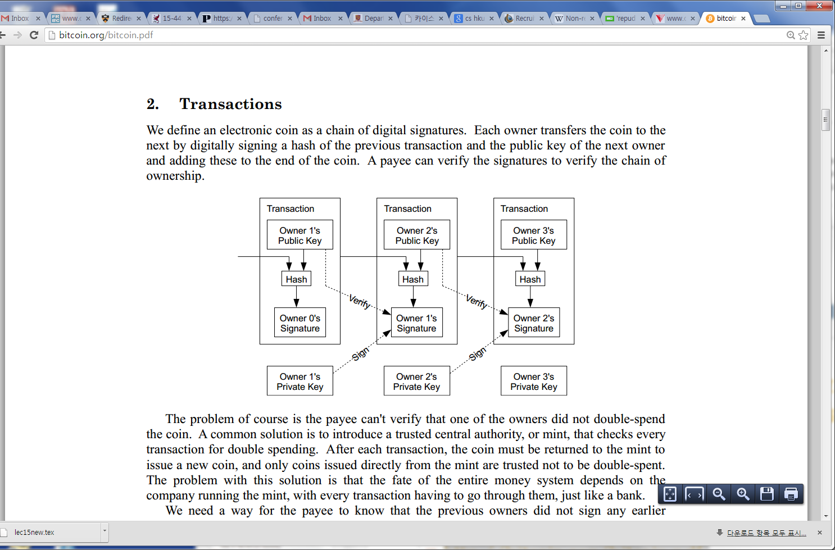
Bitcoin
Electronic coin == chain of digital signatures
BitCoin transfer: Sign(Previous transaction + New owner’s public key)
Anyone can verify (n-1)th owner transferred this to the nth owner.
Anyone can follow the history
Given a BitCoin

Slide 15

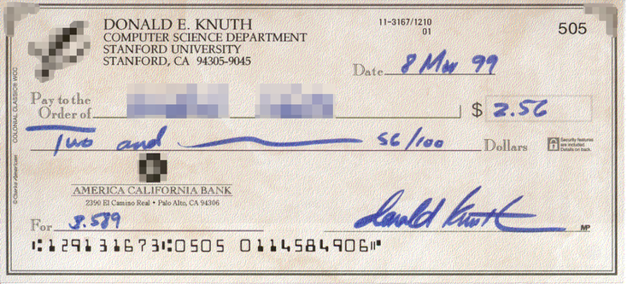
Bitcoin Transactions
Public key 0xc7b2f68...
Public key 0xa8fc93875a972ea
Signature 0xa87g14632d452cd

Slide 16
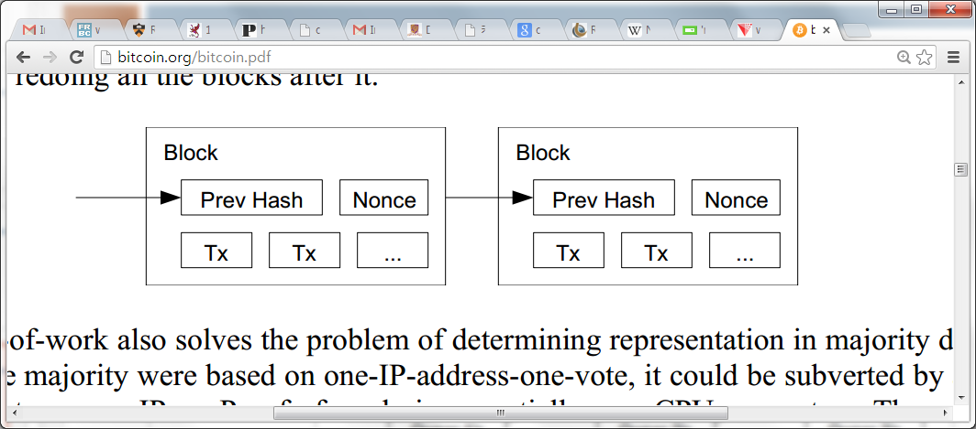
Use of Cryptographic Hashes
Proof-of-work
Block contains transactions to be validated and previous hash value.
Pick a nouce such that H(prev hash, nounce, Tx) < E. E is a variable that the system specifies. Basically, this amounts to finding a hash value who’s leading bits are zero. The work required is exponential in the number of zero bits required.
Verification is easy. But proof-of-work is hard.

Slide 17
Preventing Double-spending
The only way is to be aware of all transactions.
Each node (miner) verifies that this is the first spending of the Bitcoin by the payer.
Only when it is verified it generates the proof-of-work and attach it to the current chain.

Slide 18
Bitcoin Network
Each P2P node runs the following algorithm:
New transactions are broadcast to all nodes.
Each node (miners) collects new transactions into a block.
Each node works on finding a proof-of-work for its block. (Hard to do. Probabilistic. The one to finish early will probably win.)
When a node finds a proof-of-work, it broadcasts the block to all nodes.
Nodes accept the block only if all transactions in it are valid (digital signature checking) and not already spent (check all the transactions).
Nodes express their acceptance by working on creating the next block in the chain, using the hash of the accepted block as the previous hash.

Slide 19
Tie breaking
Two nodes may find a correct block simultaneously.
Keep both and work on the first one
If one grows longer than the other, take the longer one
Two different block chains (or blocks) may satisfy the required proof-of-work.

Slide 20
Reverting is Hard
Reverting gets exponentially hard as the chain grows.
2. Recompute nonce
3. Recompute the next nonce
1. Modify the transaction (revert or change the payer)

Slide 21
Practical Limitation
At least 10 mins to verify a transaction.
Agree to pay
Wait for one block (10 mins) for the transaction to go through.
But, for a large transaction ($$$) wait longer. Because if you wait longer it becomes more secure. For large $$$, you wait for six blocks (1 hour).

Slide 22
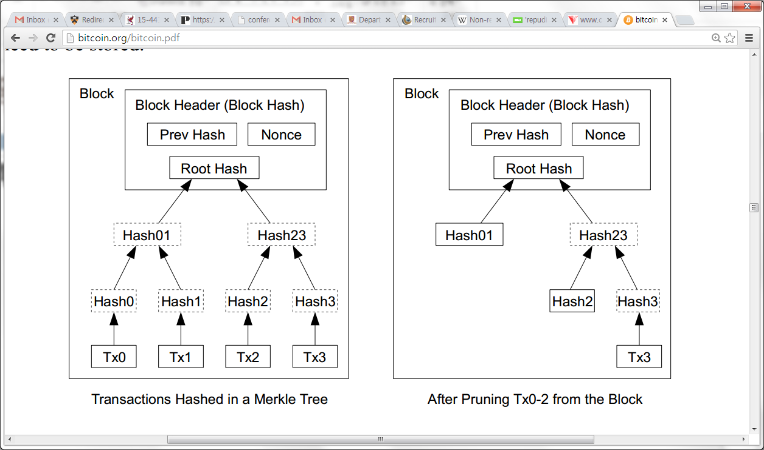
Optimizations
Merkle Tree
Only keep the root hash
Delete the interior hash values to save disk
Block header only contains the root hash
Block header is about 80 bytes
80 bytes * 6 per/hr * 24 hrs * 365 = 4.2 MB/year
Why keep use a Merkle tree?

Slide 23
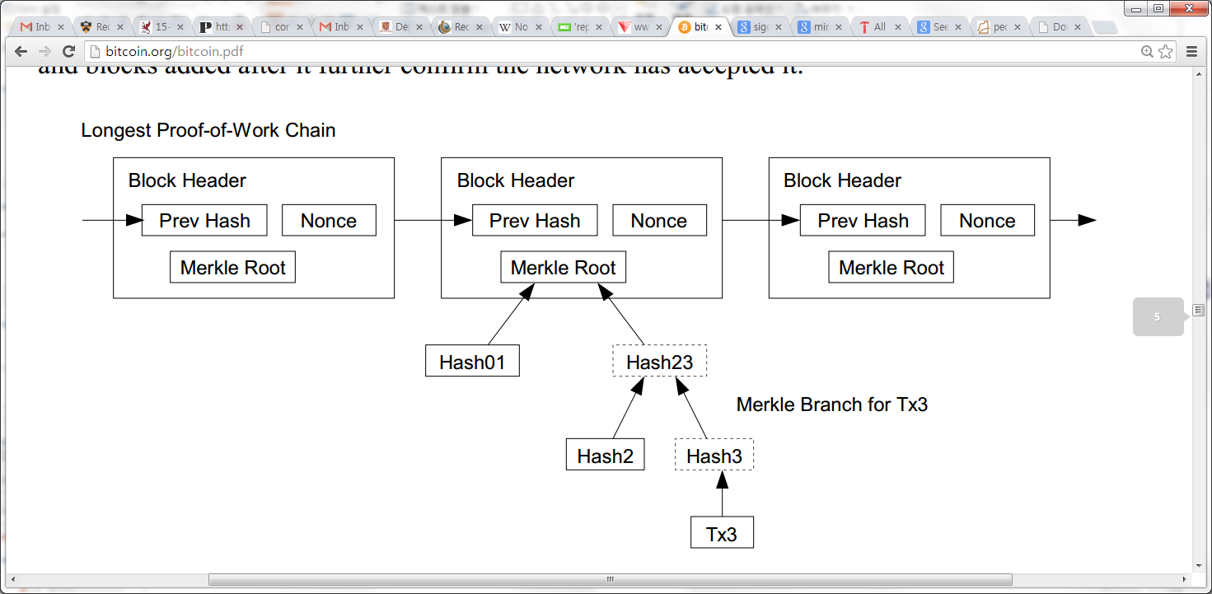
Simplified payment verification
Any user can verify a transaction easily by asking a node.
First, get the longest proof-of-work chain
Query the block that the transaction to be verified (tx3) is in.
Only need Hash01 and Hash2 to verify; not the entire Tx’s.

Slide 24
BitCoin Economics
Rate limiting on the creation of a new block
Adapt to the “network’s capacity”
A block created every 10 mins (six blocks every hour)
How? Difficulty is adjusted every two weeks to keep the rate fixed as capacity/computing power increases
N new Bitcoins per each new block: credited to the miner → incentives for miners
N was 50 initially. In 2013, N=25.
Halved every 210,000 blocks (every four years)
Thus, the total number of BitCoins will not exceed 21 million. (After this miner takes a fee)

Slide 25
Privacy Implications
No anonymity, only pseudonymity
All transactions remain on the block chain– indefinitely!
Retroactive data mining
Target used data mining on customer purchases to identify pregnant women and target ads at them (NYT 2012), ended up informing a woman’s father that his teenage daughter was pregnant
Imagine what credit card companies could do with the data

Slide 26
Zerocoin
A distributed approach to private electronic cash
Extends Bitcoin by adding an anonymous currency on top of it
Zerocoins are exchangeable for bitcoins

Slide 27


What is a zerocoin?
A zerocoin is:
Economically: a promissory note redeemable for a bitcoin
Cryptographically: an opaque envelope containing a serial number used to prevent double spending
823848273471012983

Slide 28

Commitments
812...
Allow you to commit to and later reveal a value
Binding: value cannot be tampered with
Blinding: value cannot be read until revealed
812..

Slide 29
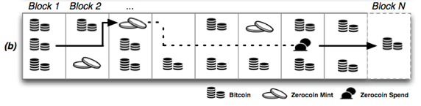
Zerocoins: where do they come from?
Anyone can make one
Choose a random serial number and commit to it
Mint a zerocoin by putting a mint transaction in the block chain which “spends” a bitcoin and includes the commitment
Spending a zerocoin gives the recipient a bitcoin

Slide 30
Zerocoins: ...and where do they go?
The “spent” bitcoins end up escrowed
To spend a zerocoin
You reveal the serial number
Prove it is from some zerocoin in the block chain
Put the spent serial number in the block chain

Slide 31
Zero-knowledge proofs
Zero-knowledge [Goldwasser, Micali 1980s, and beyond]
Prove knowledge of a witness satisfying a statement
Specific variant: non-interactive proof of knowledge
Here we prove we know:
The serial number of a zerocoin
That the coin is in the block chain

Slide 32


Zero-knowledge proof
Inefficient approach
Identify all valid zerocoins in the block chain (call them )
Prove that S is the serial number of a coin C and
This “OR” proof is O(N)
Zerocoin uses cryptographic accumulators
Sublinear

Slide 33

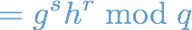
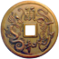
Zerocoin protocol
Generate a commitment to a random serial number S:
(Store serial number S and randomness r)
Accumulate all valid coins, compute witness wi
Reveal S and prove knowledge of witness to commitment accumulation and its randomness r
where is prime

Slide 34
Discussion
The future of Bitcoin?
Attacks on Zerocoin?
Should we tradeoff privacy for usability? Is privacy a main principle?

Slide 35
Acknowledgement
Some of the slides, content, or pictures are borrowed from the following resources, and some pictures are obtained through Google search without being referenced below:
L24-BitCoin and Security, many of the slides borrowed from this presentation with modifications.
Ian Miers, Zerocoin: Anonymous Distributed E-Cash from Bitcoin, IEE S&P slides

